Slide 1
DMFabric
A blockchain Solution for Disaster Management
A POC submitted by Atul Sarpotdar (Team CODEMIND) for CALL FOR CODE

Slide 2
Why we need a better Disaster Management Solution ?
World has seen many crisis situations because of various kinds of natural disasters where victims have to leave their houses, find necessary services for surviving such as food, medical, transport. They often do not have necessary funds to avail these kind of services in these situations.
Governments, multiple organizations, volunteers provide their help or generally have necessary will to provide their help during these natural disasters but below mentioned issues limit these efforts.
Lack of secure environment where all parties are verified and accountable
Lack of trusted & transparent channel to prevent mismanagement of funds & services (so that there are no conflict scenarios with respect to these)
Lack of necessary ecosystem where existing enterprise systems & channels are integrated esp. for service providers
Lack of the real-time resident tracking information based on which rescue operations can be initiated.
The objective behind DMFabric is to develop and establish an environment addressing above mentioned and other significant issues for overall better Disaster Management

Slide 3
How DMFabric solves our problem ?
DMFabric Application builds an ecosystem/network with combined use of multiple technology platforms available today and provides a technical solution we are looking for by addressing mentioned problems.
Mobile & Web Application Platform to provide single channel to access this ecosystem
Blockchain Platform – It creates a secure, resilient, traceable, trusted and transparent business network for Disaster Management It facilitates effective communication and on time response for participants/ organizations during crisis situation. With Blockchain’s shared distributed ledger all transactions are logged on to the network. Service providers can connect to Blockchain network using their existing eco systems for publishing their services and communicate with other participants. Thus it provides a platform or ecosystem for disaster management and brings governance in system. Blockchain’s key characteristics help to establish a trusted & transparent environment for business where transactions can be settled faster and efficiently.
Cloud Platform for providing high availability, more security and scalability for this ecosystem

Slide 4
Key Features
Front End Mobile & Web Application and Service API Interfaces - The DMFabric network provides one platform to connect the residents, service providers and funds providers ( their existing enterprise systems ) using APIs
Payment Wallet – Once registered, system will activate a payment wallet for affected residents/victims. The fund providers and Government & Banks can add money to these wallets directly to provide more transparency in fund distribution. Then residents can use this wallet money to avail any paid services as and when needed.
This again provides an alternative and efficient way for payment in crisis situations instead of using cash or cards. A payment mechanism using VPA (Virtual Payment Address), UPI (Unified Payments Interface) and MPIN can be used for these payment wallets which will be convenient and secure.
Single View – The system will provide a single view for residents (who actually know ground reality than the Government) & service providers to help each other by connecting them in more structured way. They don’t need to rely on various social media platforms for information they need

Slide 5
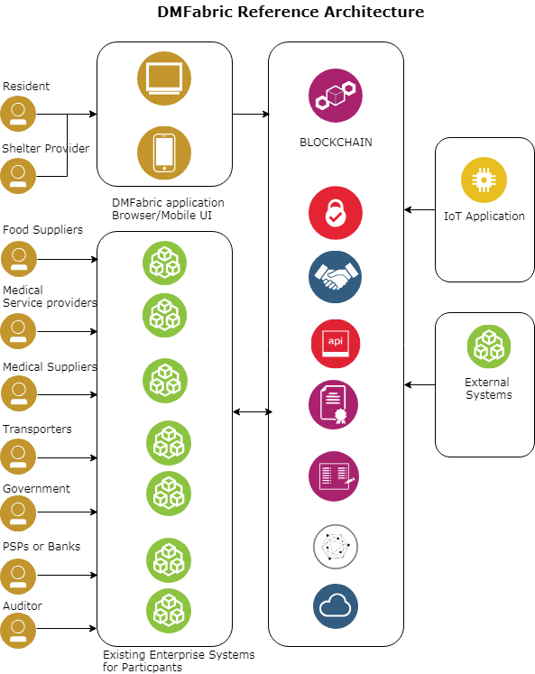
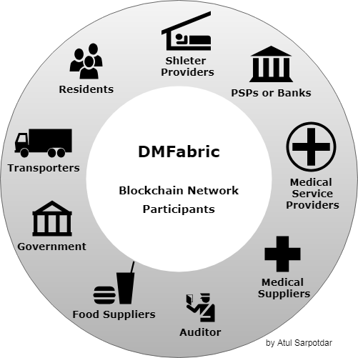
DMFabric Blockchain Network

Slide 6
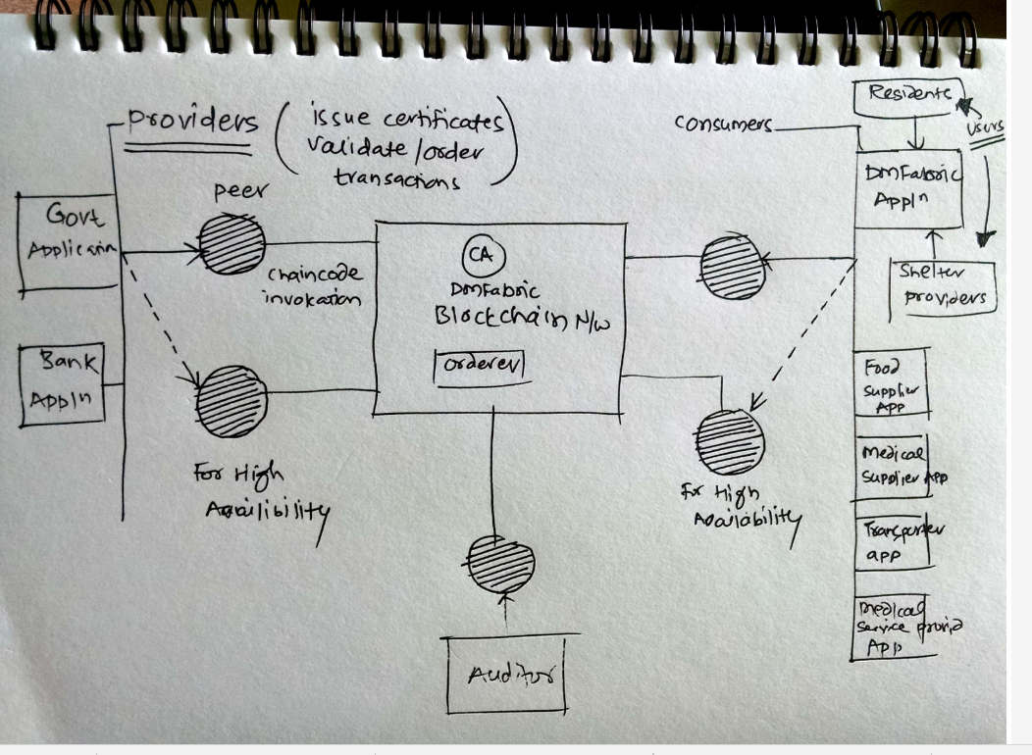
DMFabric Network Diagram

Slide 7
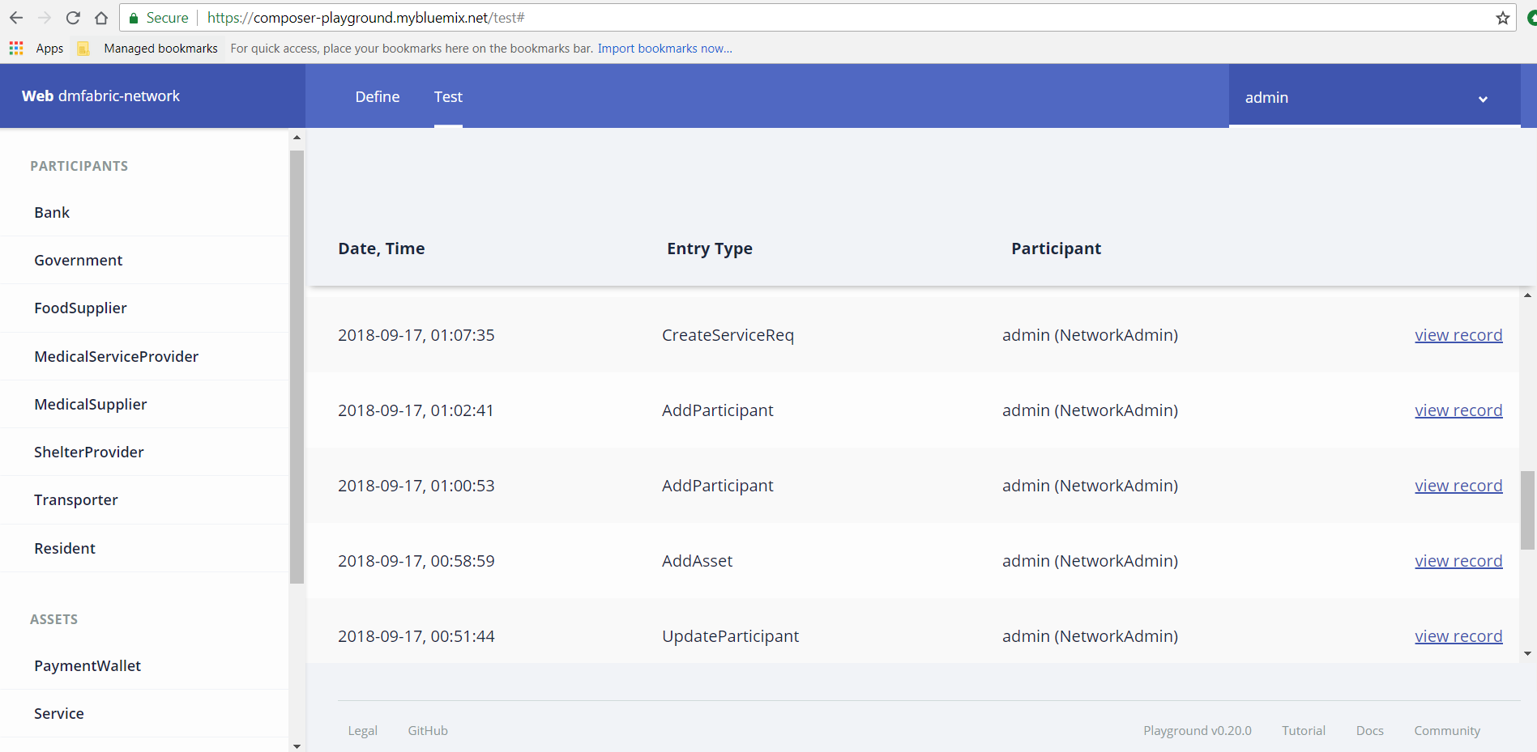

Slide 8
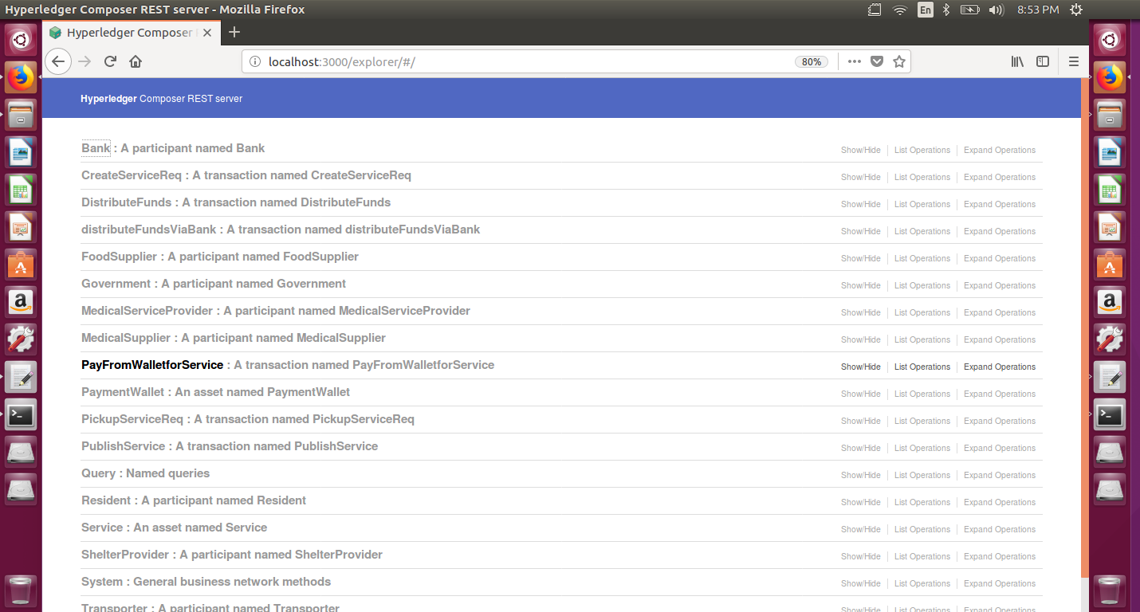
A local HYPERLEDGER REST SERVER showing DMFabric APIS

Slide 9
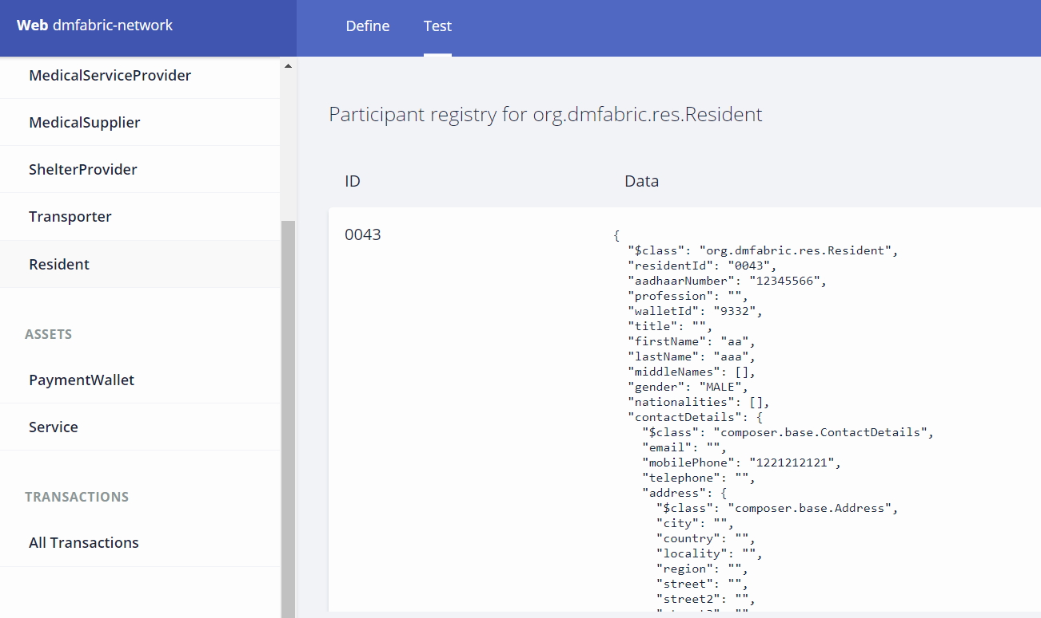
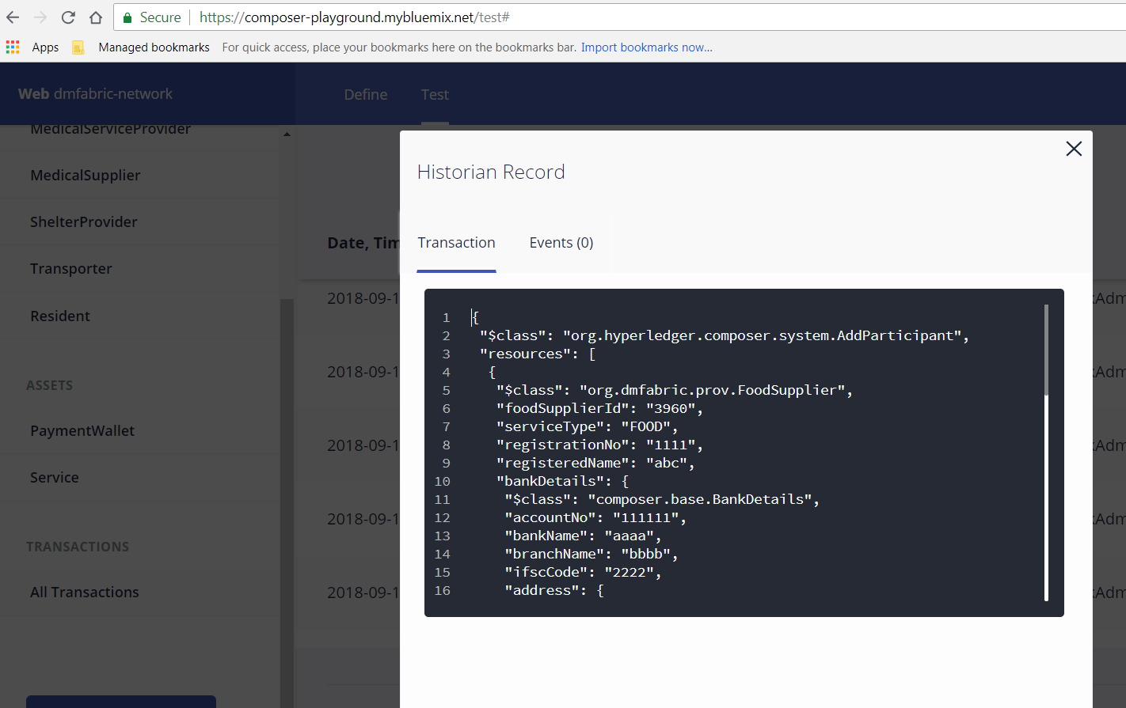
Participant Registration

Slide 10
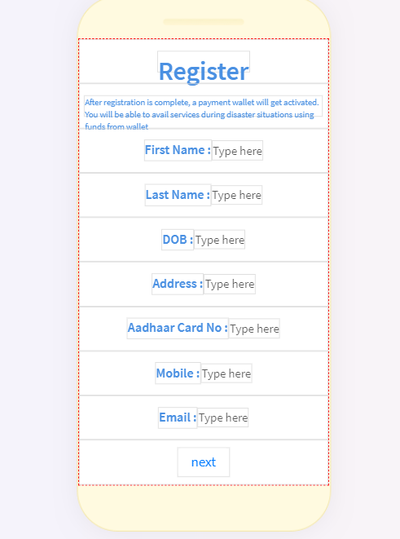
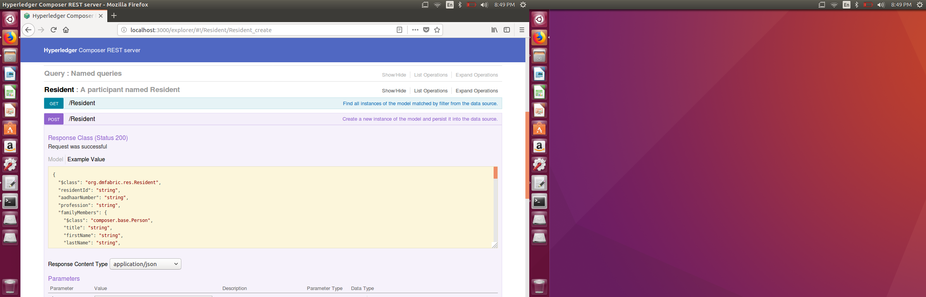
App UI Screen & REST APIs

Slide 11
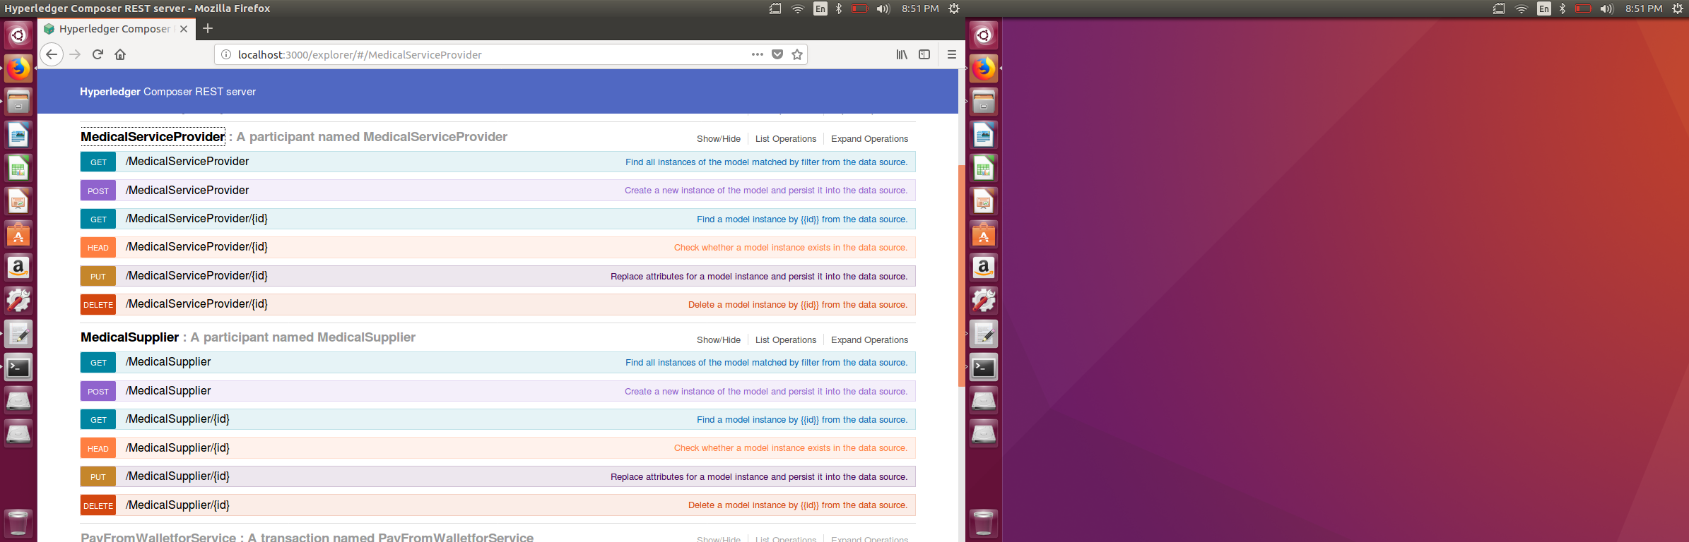
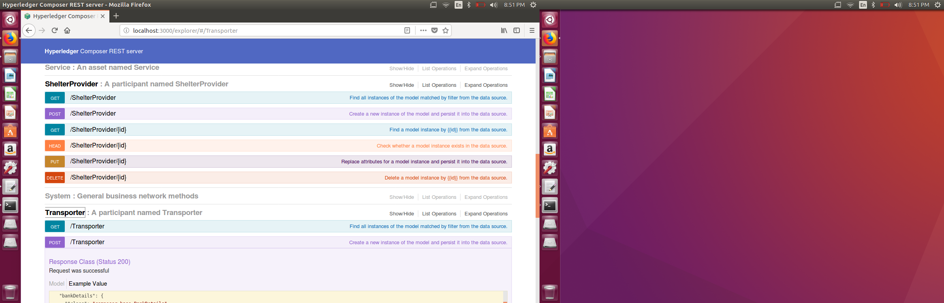
REST APIs for participants

Slide 12
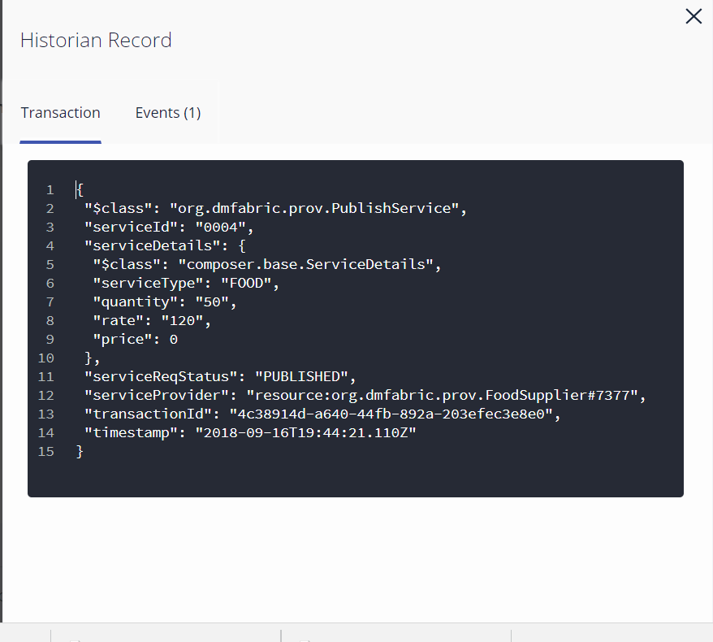
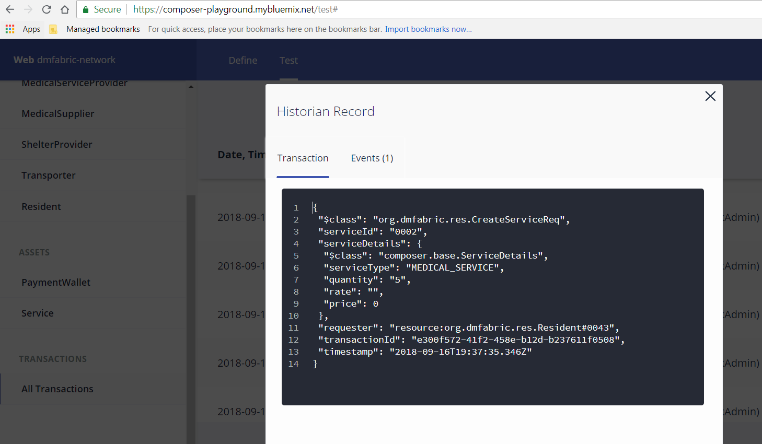
Create Service Request & Publish Service Offering
Resident’s will request for service using DMFabric app interface and service providers will have their existing enterprise systems updated to access blockchain network to publish their services on platform

Slide 13
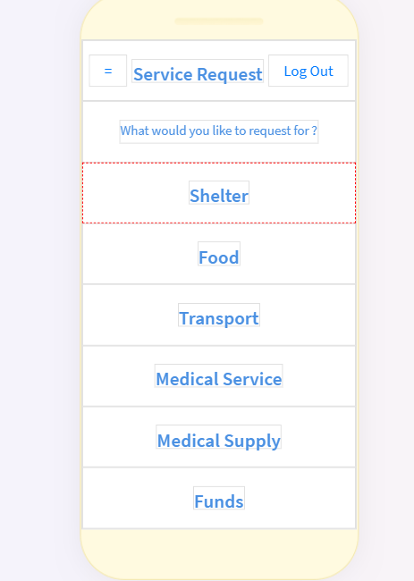
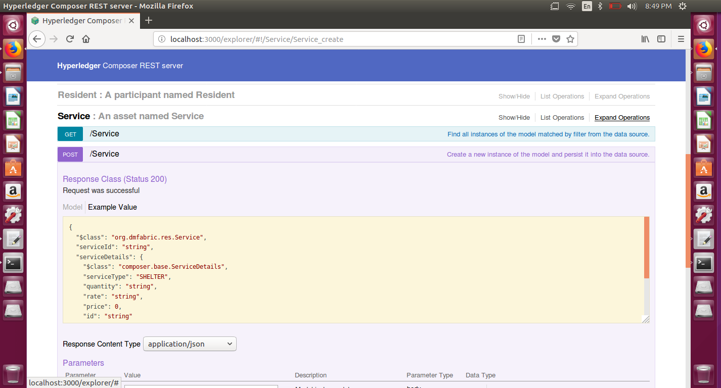
App UI for Service Request & REST API

Slide 14
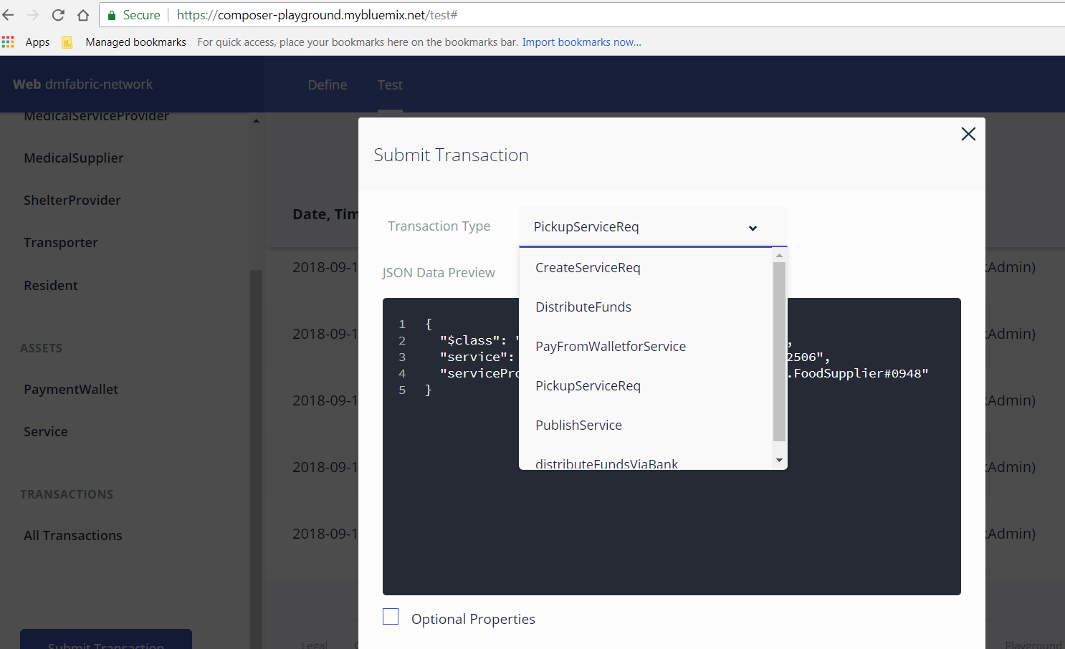
Pick Up Service Request Transaction
Whoever first accepts the service request gets automatically assigned to that service in network. Its like an contract based on criteria match. This particular transaction will get executed for this mapping

Slide 15
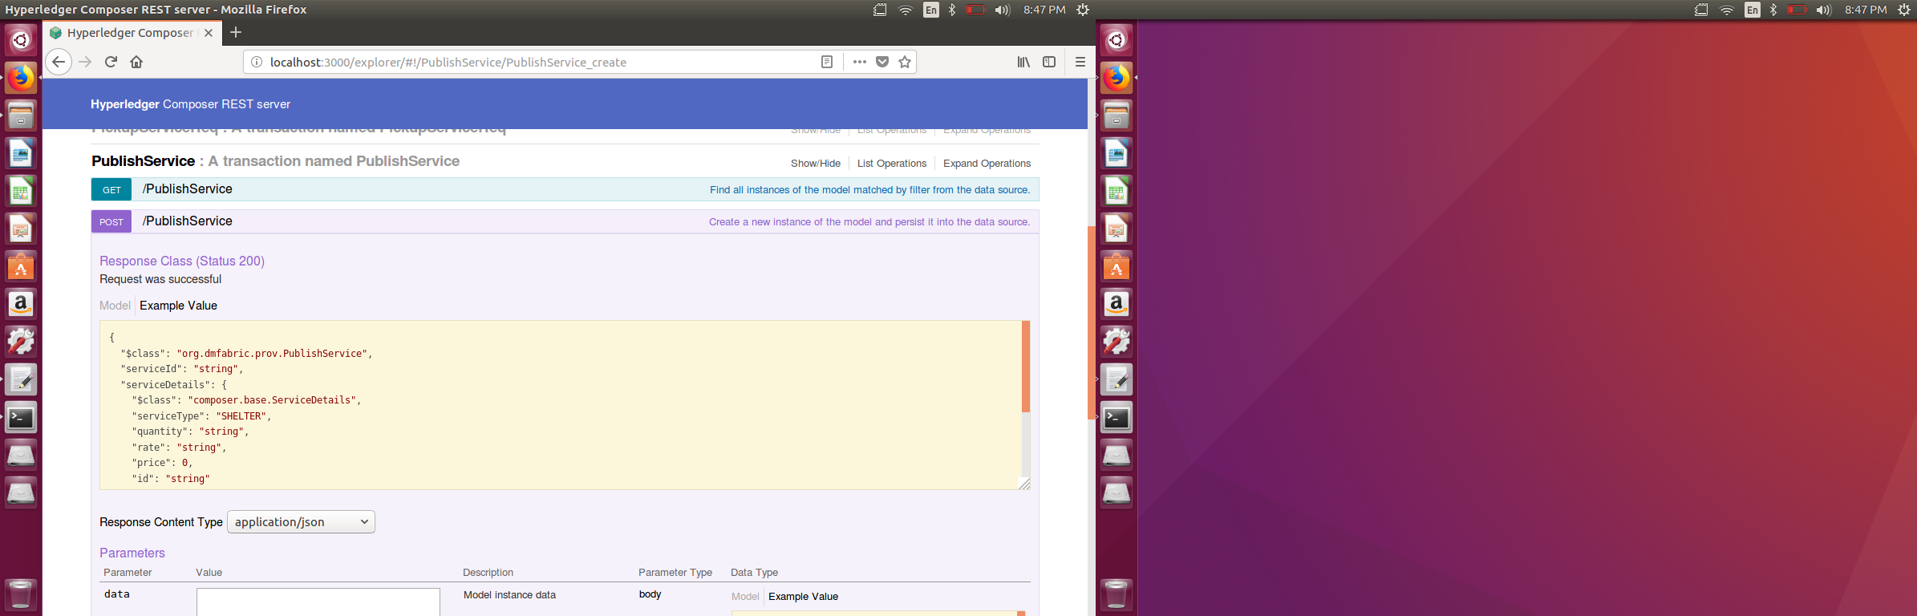
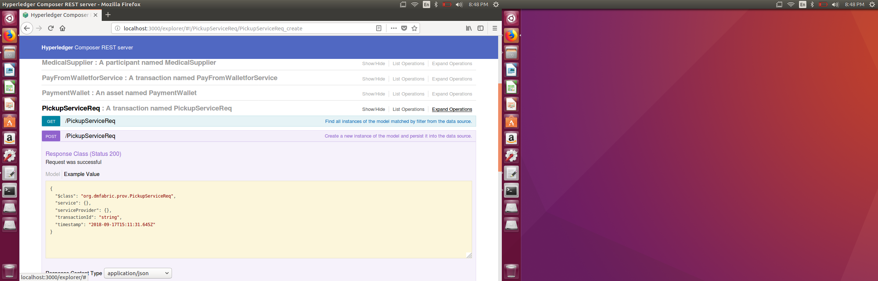
REST APIs

Slide 16
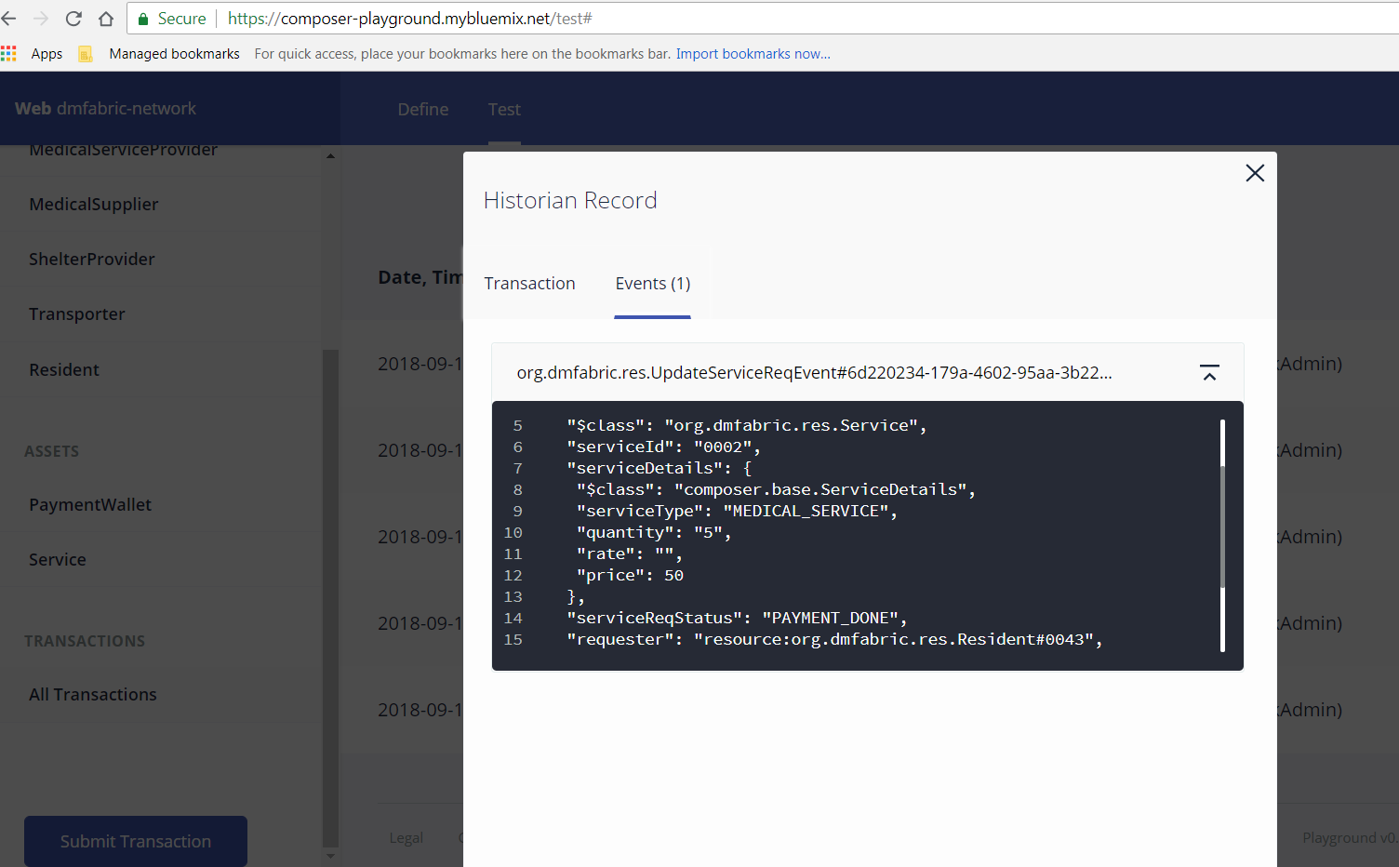
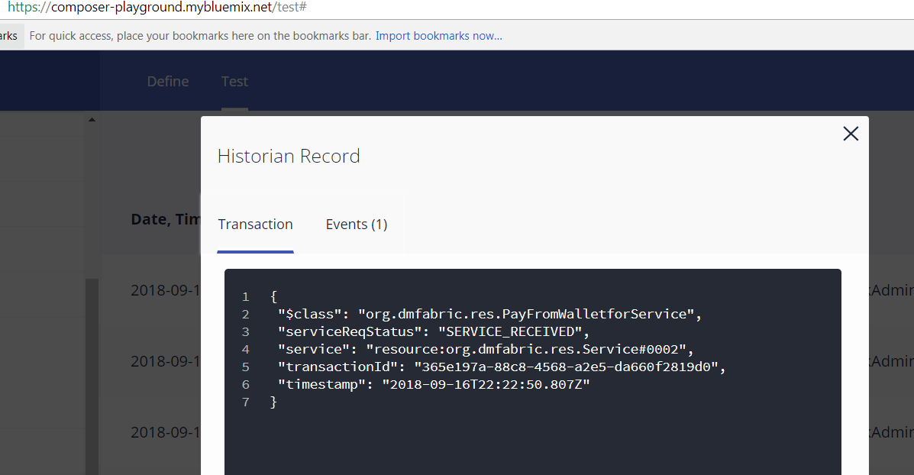
Pay from Wallet for Service Availed
Once service is received or fulfilled then smart contract will get executed
and service provider will get paid from wallet money automatically

Slide 17
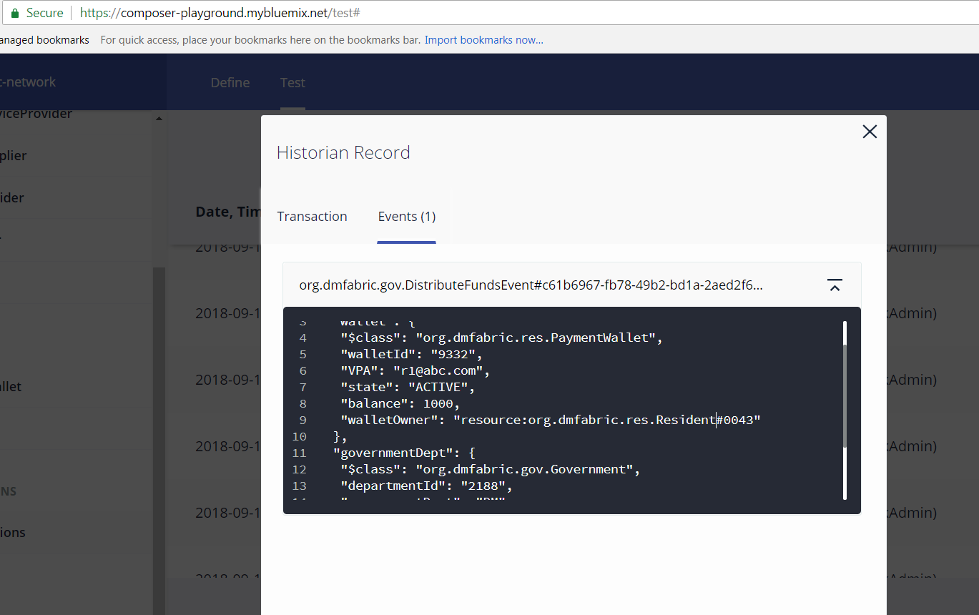
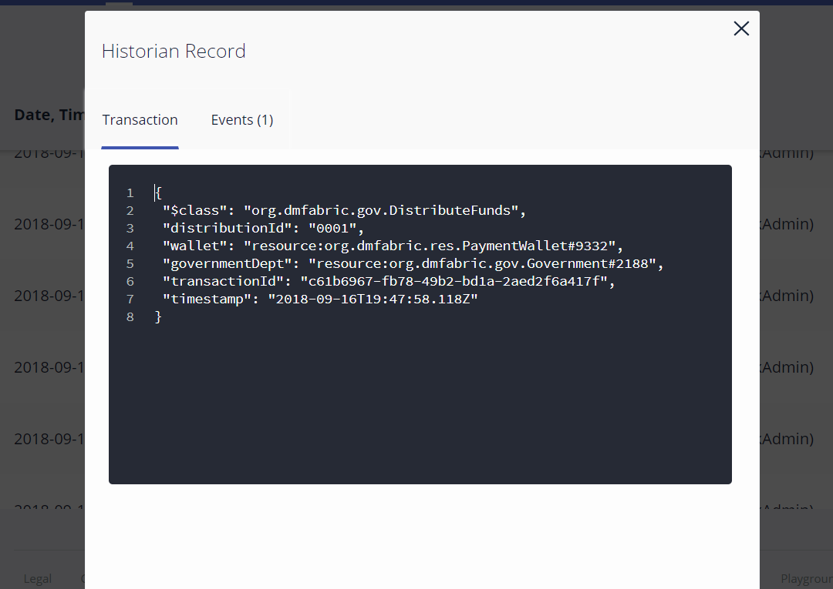
Payment Wallet
Government can directly distribute funds to resident’s Wallet.
Wallet balance will get updated accordingly.

Slide 18
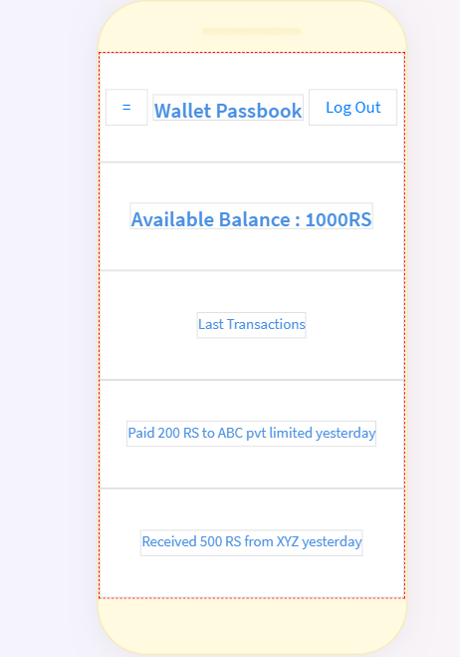
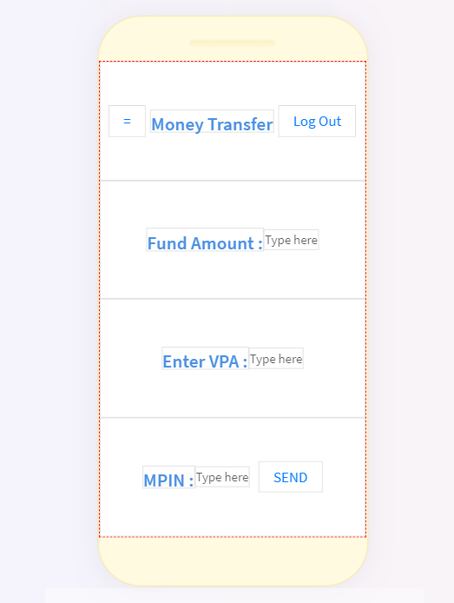
Payment Wallet app screen
Resident can see their last transactions from wallet. If required they can even request for funds in their wallet during crisis situations.
Family members will have VPAs (Virtual Payment Address) of each other so that they can transfer funds from their respective wallets Hassel free

Slide 19
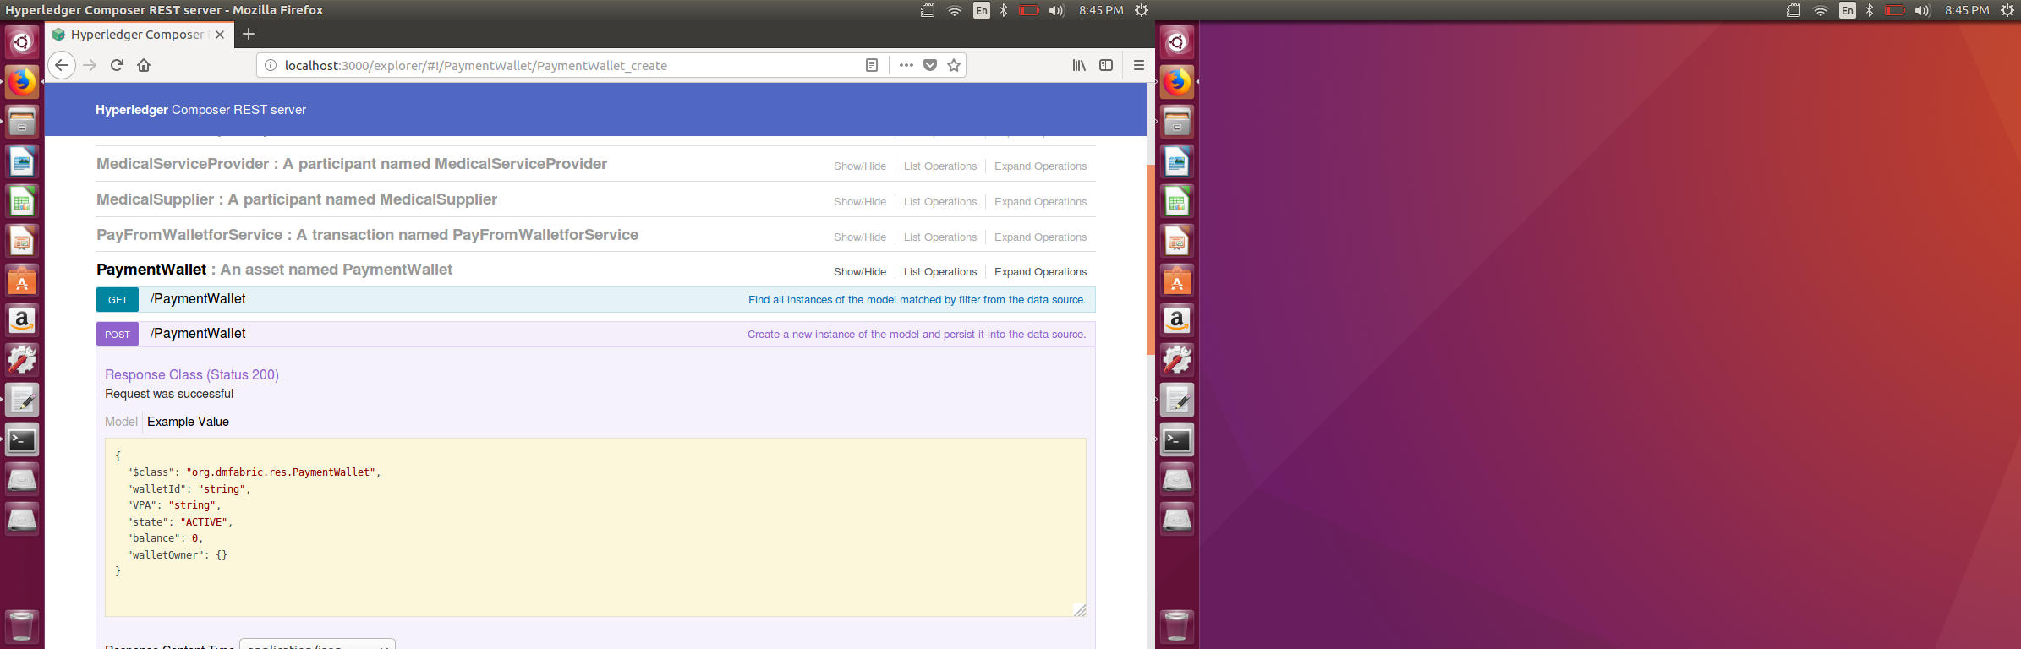
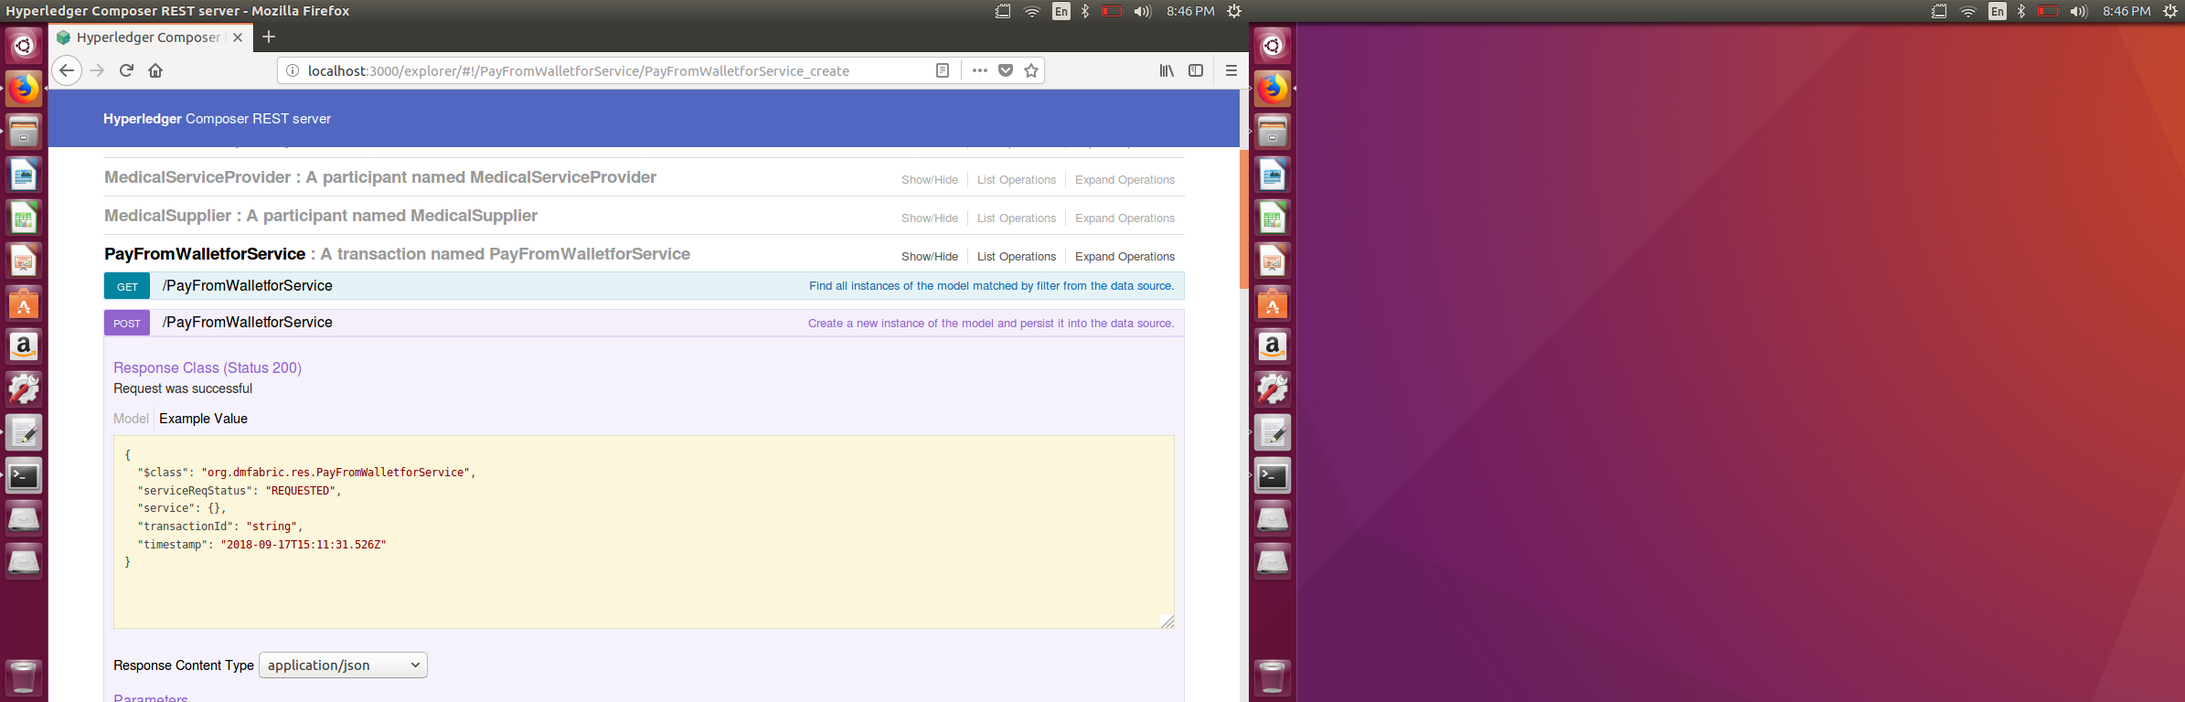
REST APIs

Slide 20
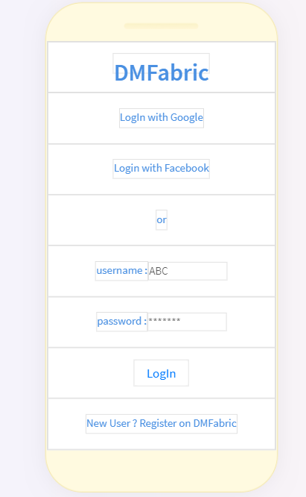
Log In using IBM App ID
App ID for authentication (email/password login, social login, or enterprise login) to web and mobile apps which secures Cloud-native applications and services on IBM Cloud

Slide 21
IBM Services
IBM Blockchain Platform
Hyperledger Composer – provides abstraction layer for Hyperledger Fabric (which leverages Javascript)
Hyperledger Fabric - Hyperledger Fabric allows components, such as consensus and membership services, to be plug-and-play. Hyperledger Fabric leverages container technology to host smart contracts called “chaincode” that comprise the application logic of the system
IBM Bluemix – to host blockchain
IBM Push Notifications - to popup alerts on the mobile & web
IBM Mobile Foundation - to provide offline capabilities for residents to get information even if they are not connected to the internet
IBM App ID – to provide the facility to login to the application using the social media identity (Google, Facebook)
IBM API Management - to provide secure access to the APIs exposed by the application.
IBM Cloudant – A distributed database based on Apache CouchDB for storing documents etc.

Slide 22
Where to go from here ?
High level solution roadmap for DMFabric application can be like -
Make necessary improvements in the DMFabric application and complete necessary integrations with different services to make it PRODUCTION READY
Integrate this Blockchain solution with IBM IoT Platform –to leverage services for Internet of Things
Get this application to actual user base and communities to test for feedback and inputs

